Slide 1
NCR Manager
Crossfire NCR Overhaul
Powered by Adestria Solutions
Notes:
Kayla

Slide 2
Data Model
Notifications
Q & A
Design & Menu
Notes:
Kayla

Slide 3
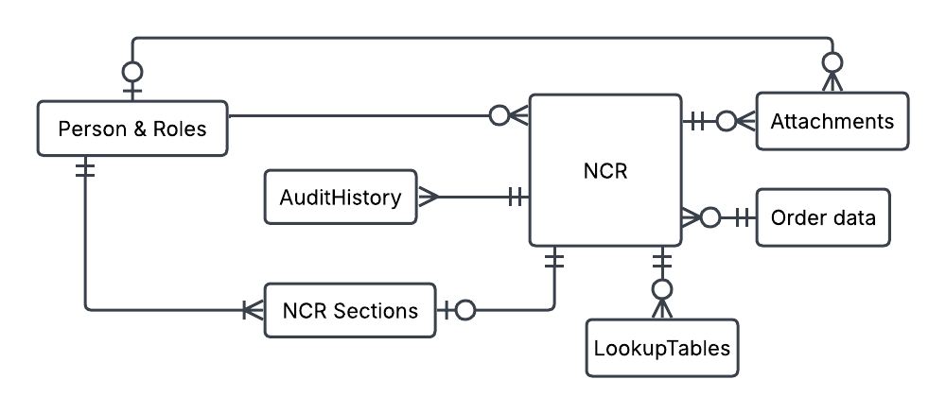
Data Model
Notes:
Jack

Slide 4
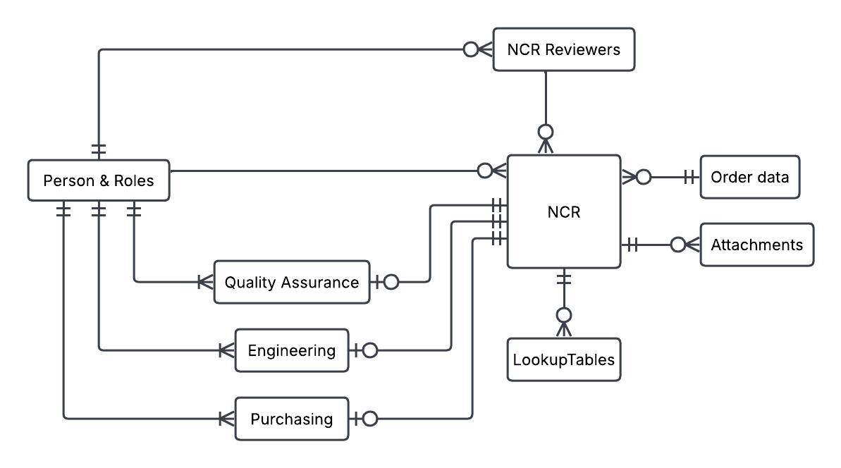
Data Model
Notes:
Jack

Slide 5
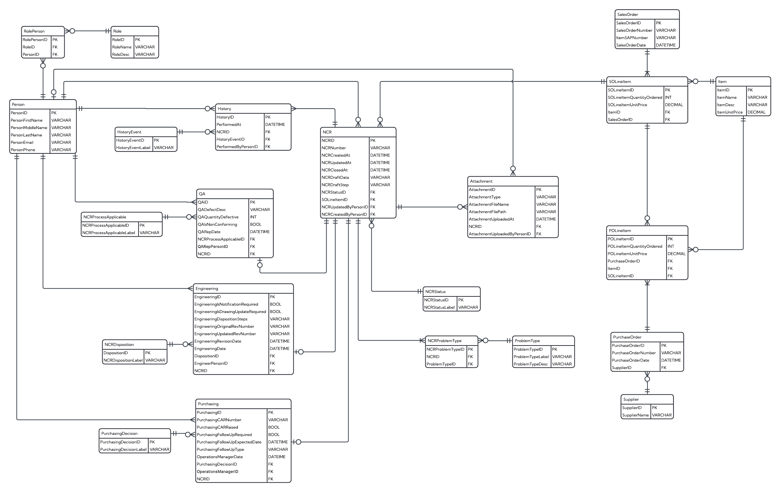
Data Model
Notes:
Jack

Slide 6


Notifications
Notes:
Steve

Slide 7
Q & A
Notes:
Kayla

Slide 8
Design & Menu
Notes:
Steve

